Slide 1

Hospital Management Analysis

Slide 2
Agenda
01 | Introduction
02 | Schema
03 | Python
04 | SQL
05 | Power BI
06 | Summary

Slide 3
Introduction
This project focuses on analysing hospital management data to gain insights into hospital operations, patient activity, and financial performance.
The dataset was sourced from Kaggle and consists of five interconnected tables:
  Patients: Patient demographics and insurance information.
  Doctors: Doctors' information, specializations, and experience.
  Appointments: Patient appointments, dates, and statuses.
  Treatments: Treatment details and associated costs.
  Billing: Payment information, billing amounts, and payment methods

Slide 4
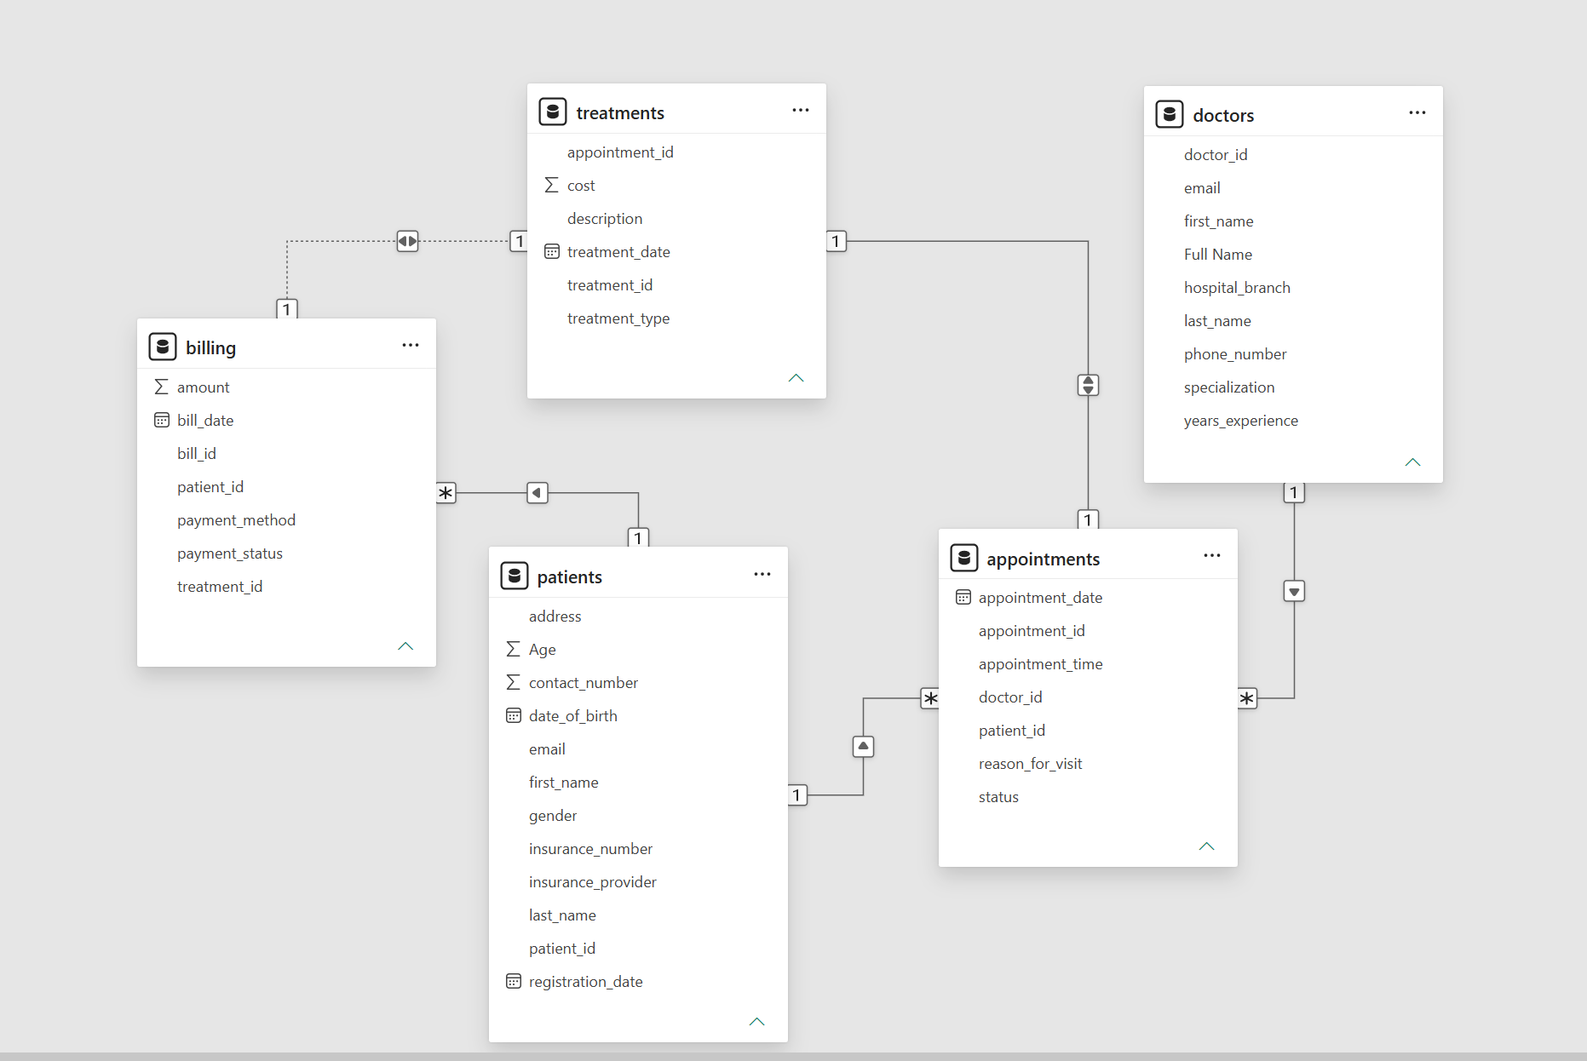
Schema

Slide 5
Python Cleaning
Table | Cleaning & transformation
Patients | Handled missing values, converted DOB, created Age and Full Name.
Doctors | Handled missing contact details and created Full Name.
Appointments | Converted dates and extracted year, month, and day of week.
Treatments | Converted dates and scaled treatment costs.
Billing | Converted dates, categorized bill amounts, and scaled amounts.

Slide 6
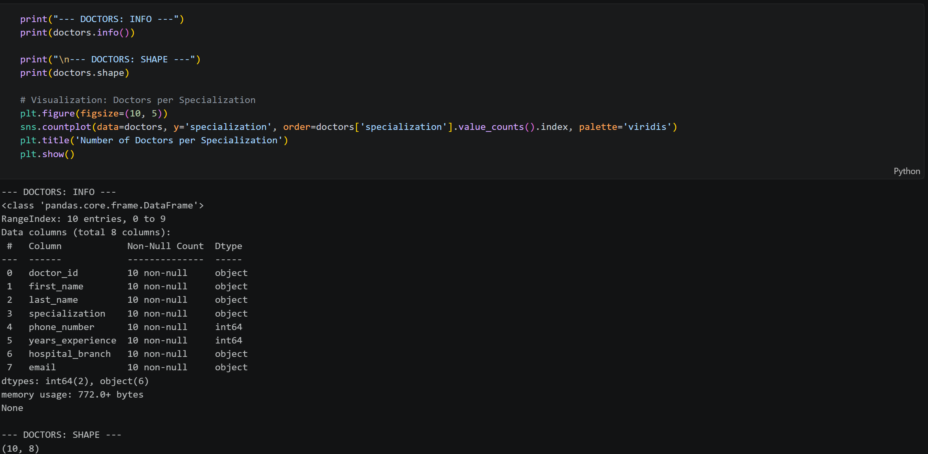

Slide 7
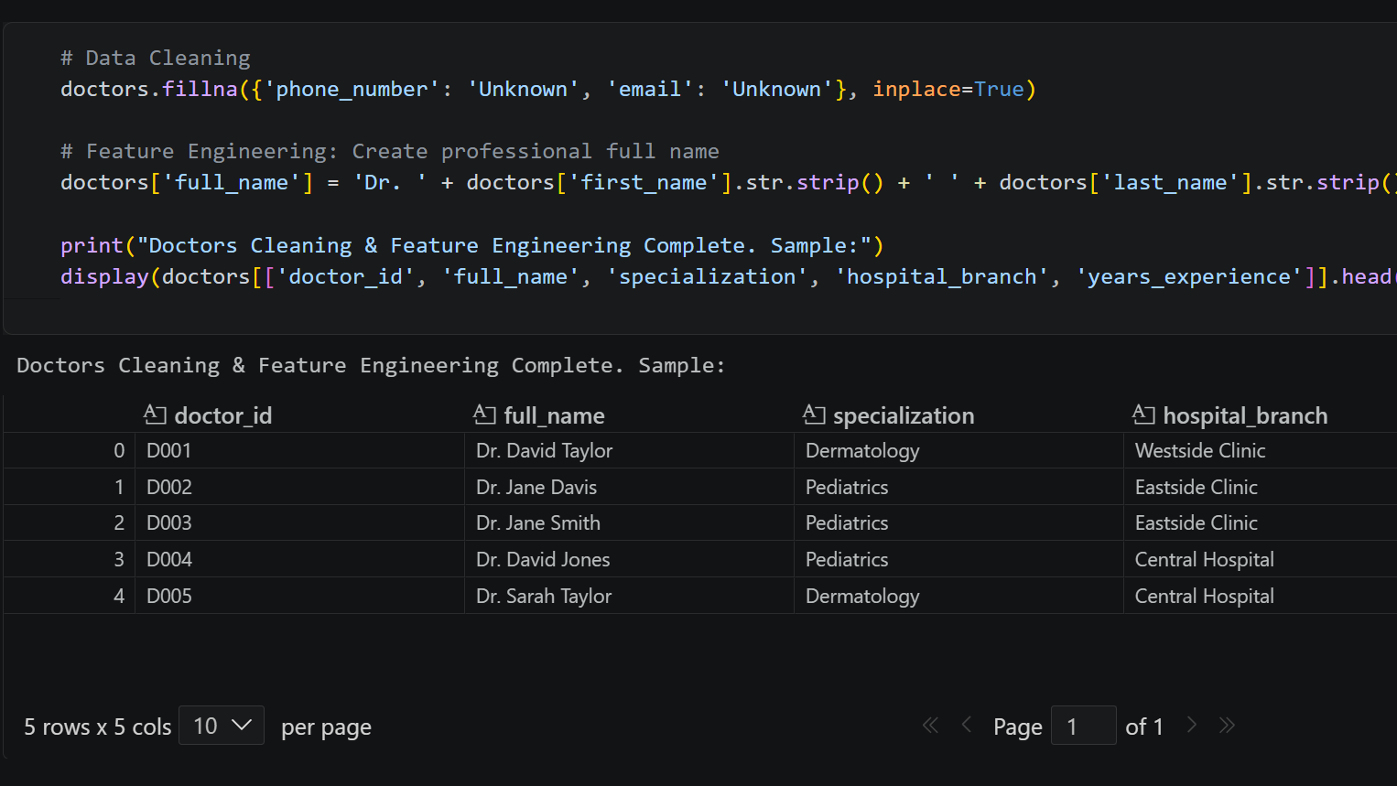

Slide 8

Python Exploration & Insights
Patients: Gender distribution and age distribution across insurance providers.
Doctors: Number of doctors by specialization and average experience across hospital branches.
Appointments: Appointment status, reasons for visits, daily appointment volume, and no-show rates by doctor.
Treatments: Treatment cost distribution and average cost by treatment type.
Billing: Payment method distribution and bill amounts across payment statuses.

Slide 9
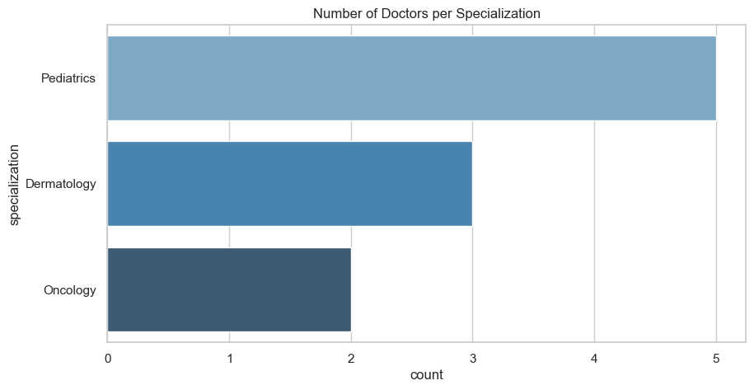

Slide 10
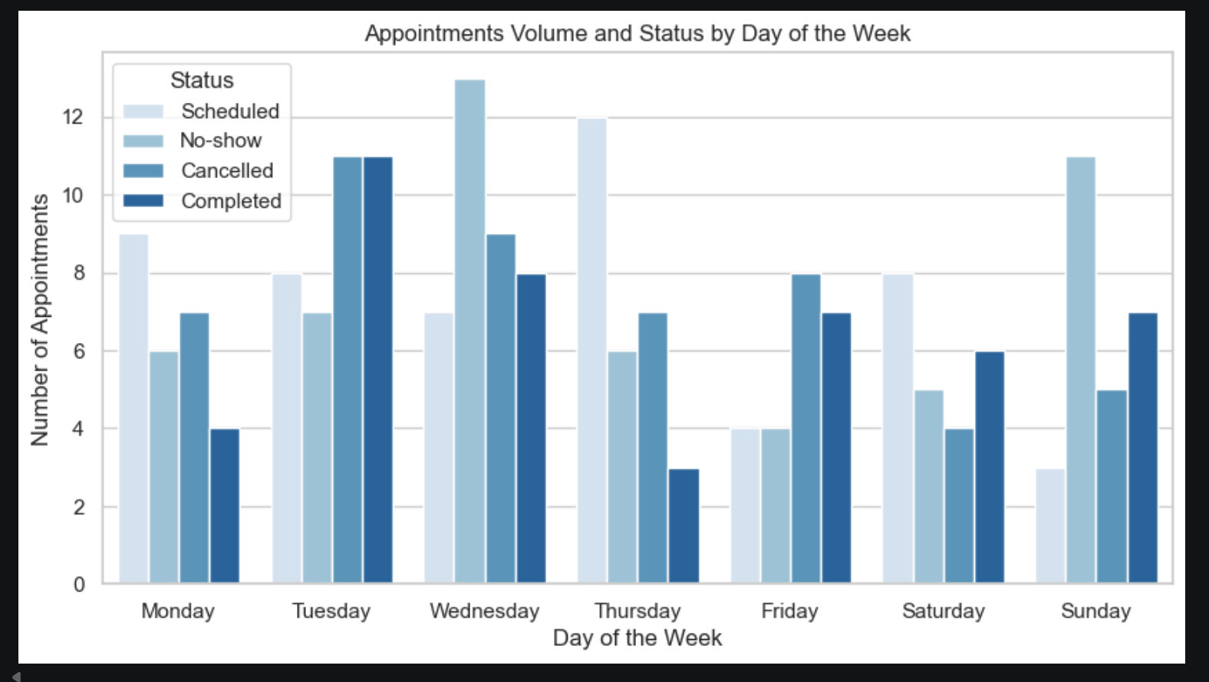

Slide 11
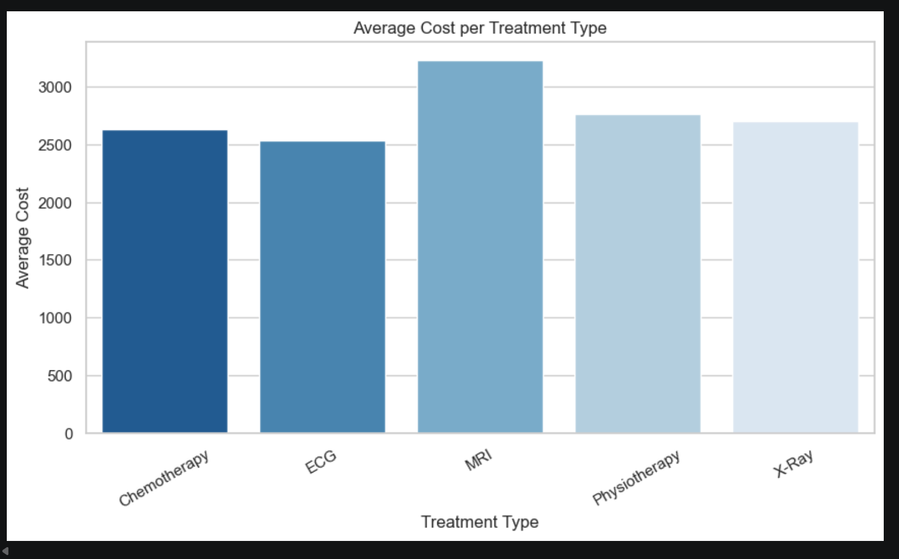

Slide 12
SQL Server Data Import
Created and selected the Hospital Management database.
Imported five CSV datasets into SQL Server:
  Patients
  Doctors
  Appointments
  Treatments
  Billing
Used SELECT * queries to validate successful data imports and inspect the tables.

Slide 13
Database Relationships & Structure
Created primary-key/foreign-key relationships using ALTER TABLE, FOREIGN KEY, and UNIQUE constraints to maintain referential integrity.
Important constraints
  Foreign keys to enforce valid references between tables.
  Unique constraints on treatments.appointment_id and billing.treatment_id to enforce one-to-one relationships.

Slide 14
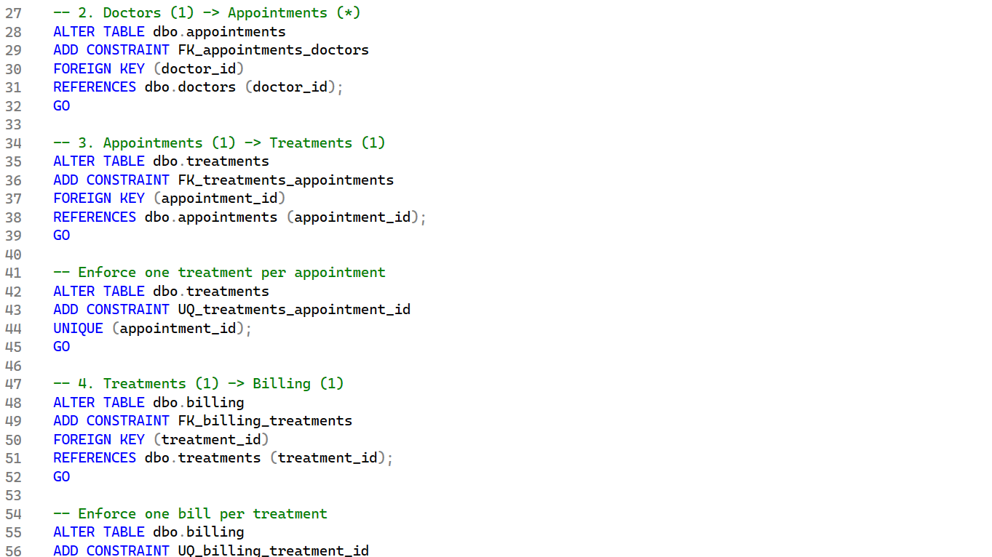

Slide 15
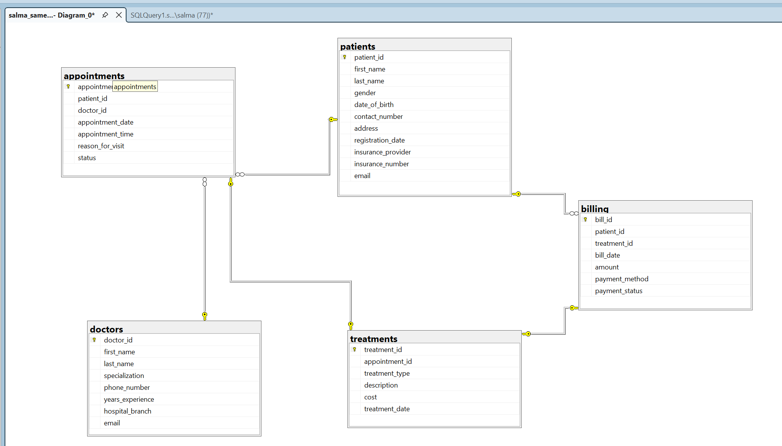
Schema

Slide 16
Business Questions & SQL Analysis
SQL techniques applied
JOIN · GROUP BY · ORDER BY · CTE · CASE WHEN · Aggregate Functions · Subqueries · TOP

Slide 17
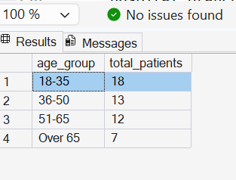
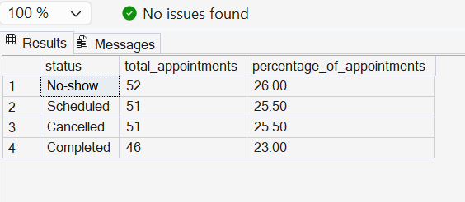
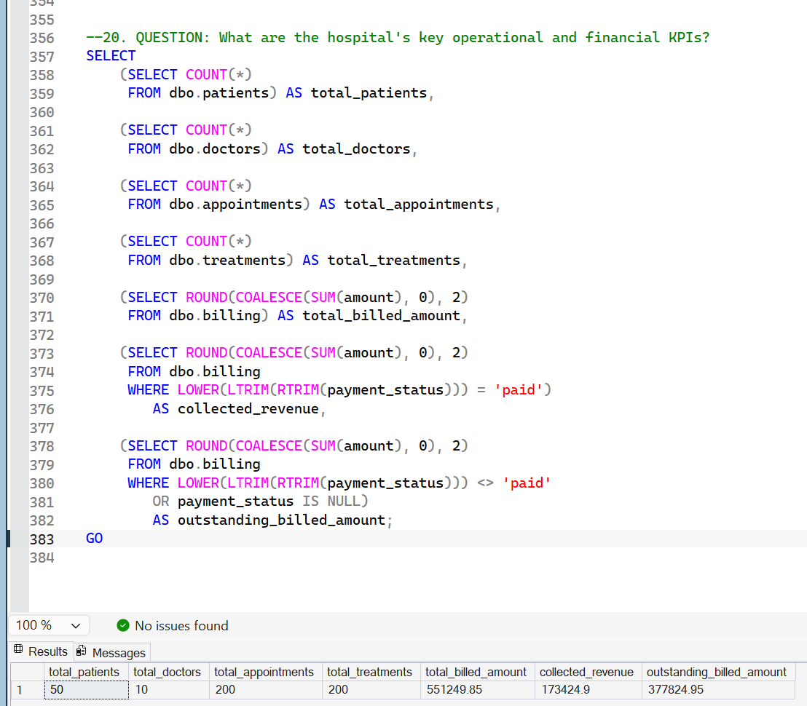
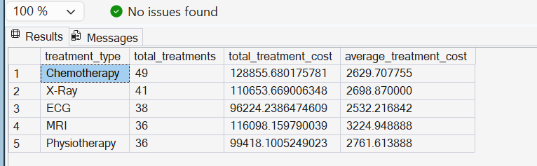

Slide 18
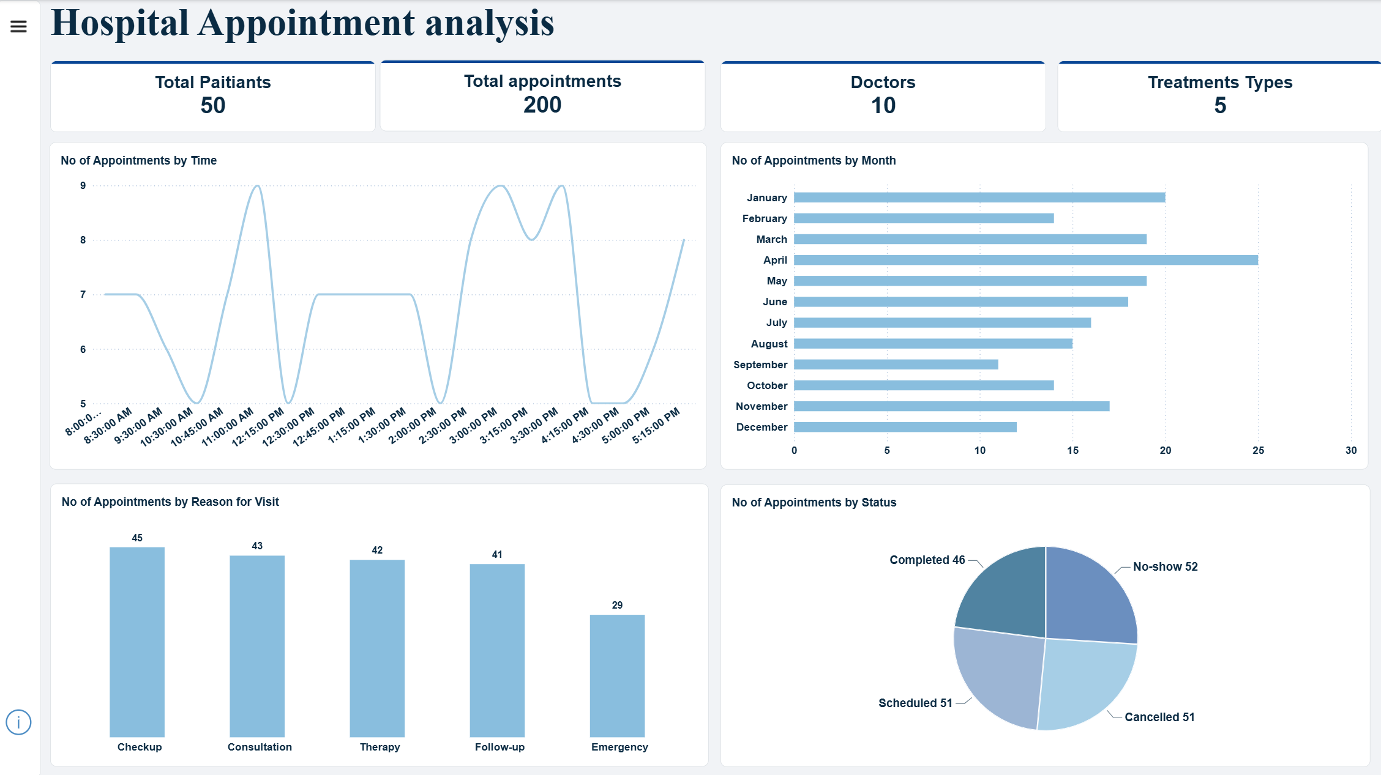
Power Bi Dashboard

Slide 19
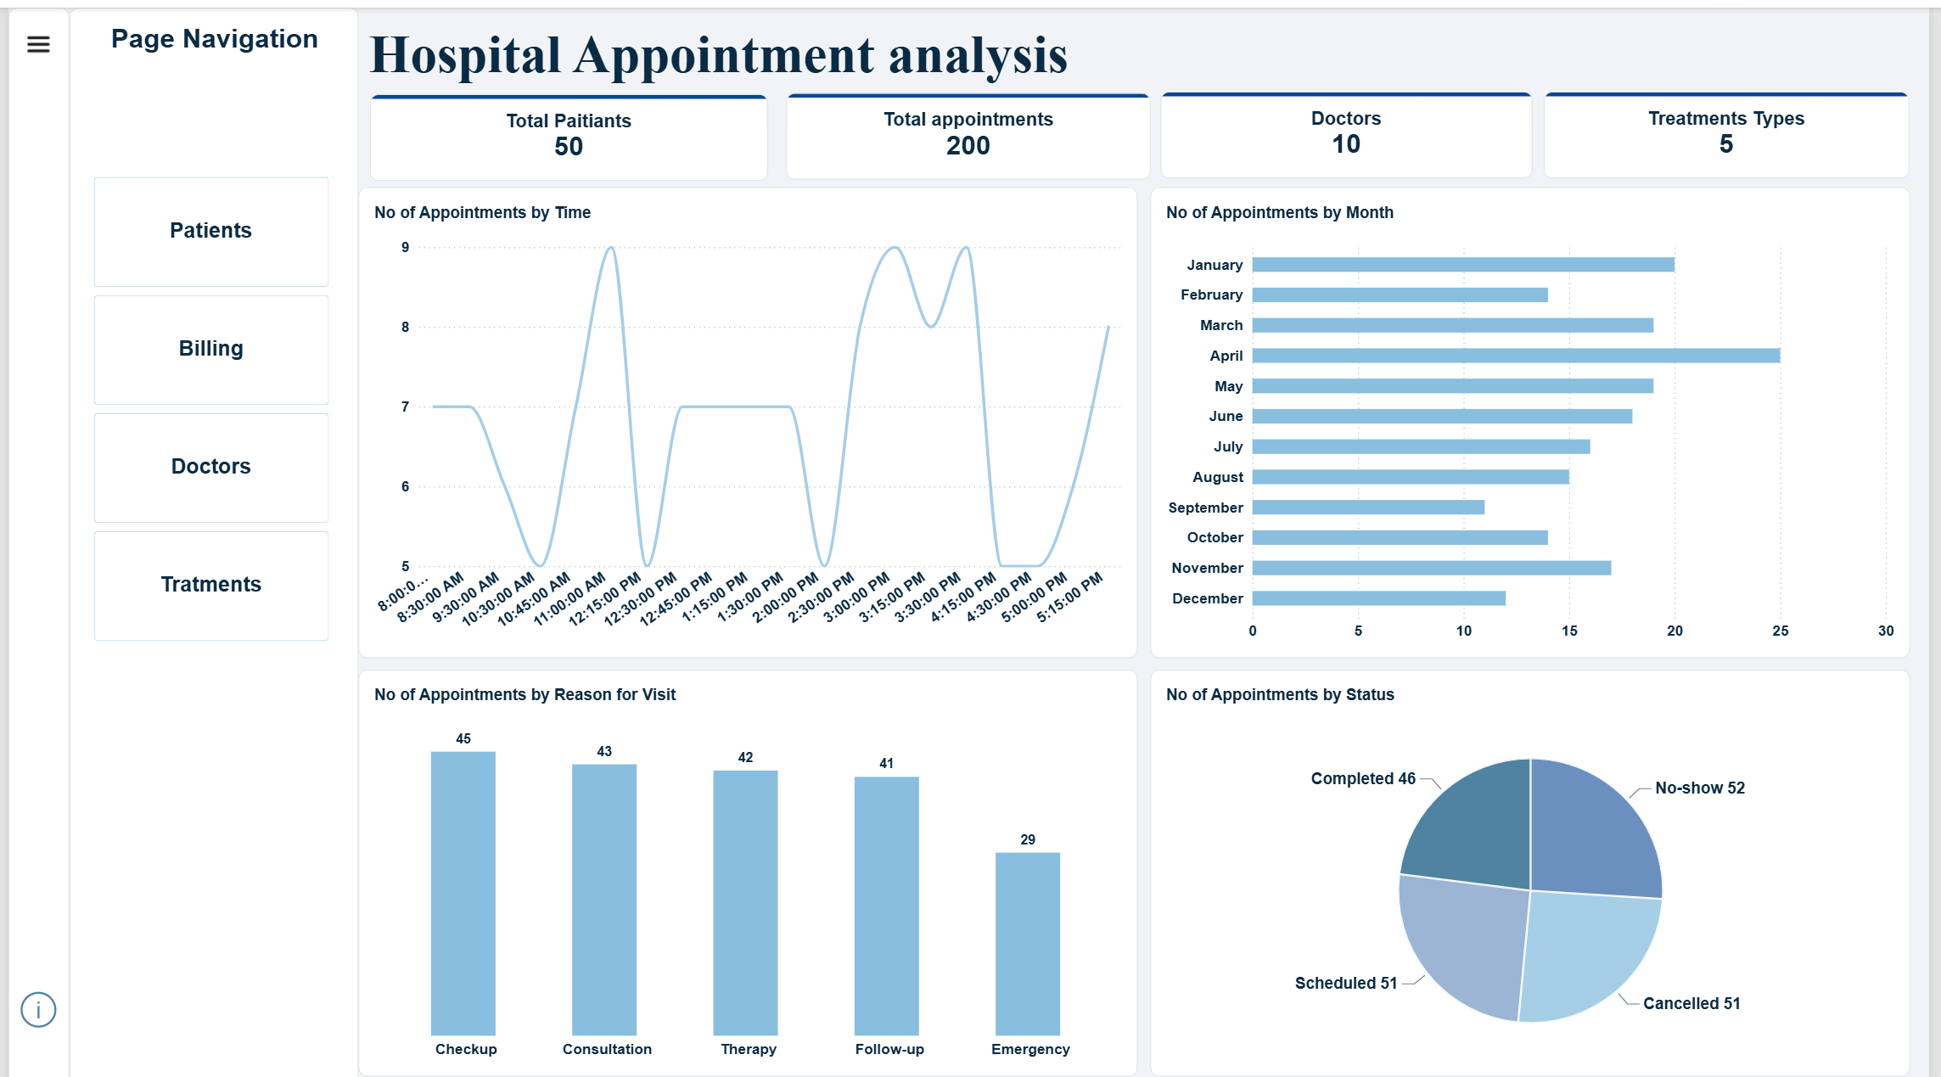
Navigation page

Slide 20
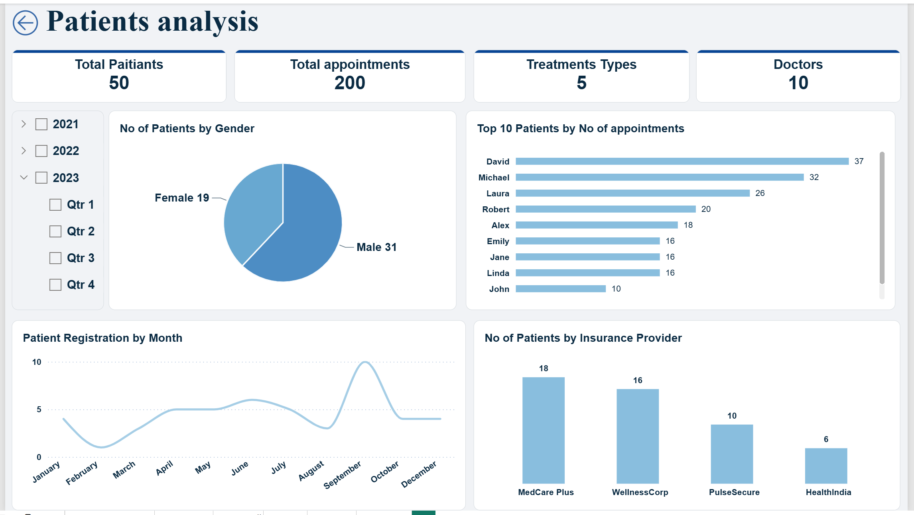
Patients

Slide 21
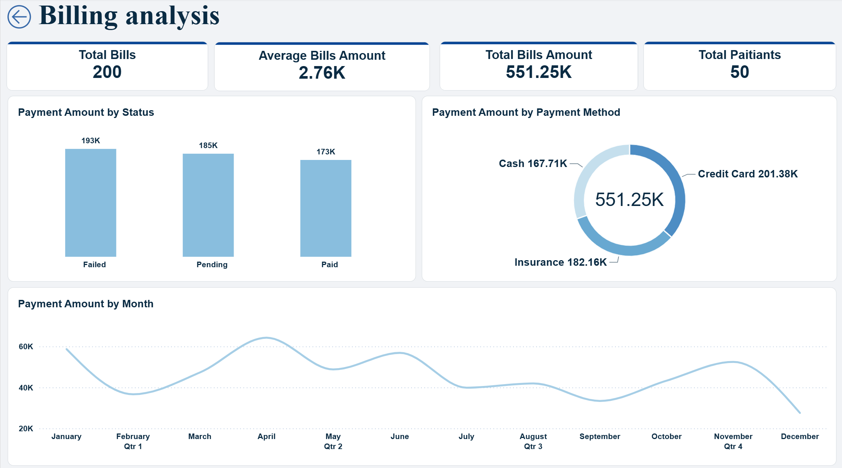
Billings

Slide 22
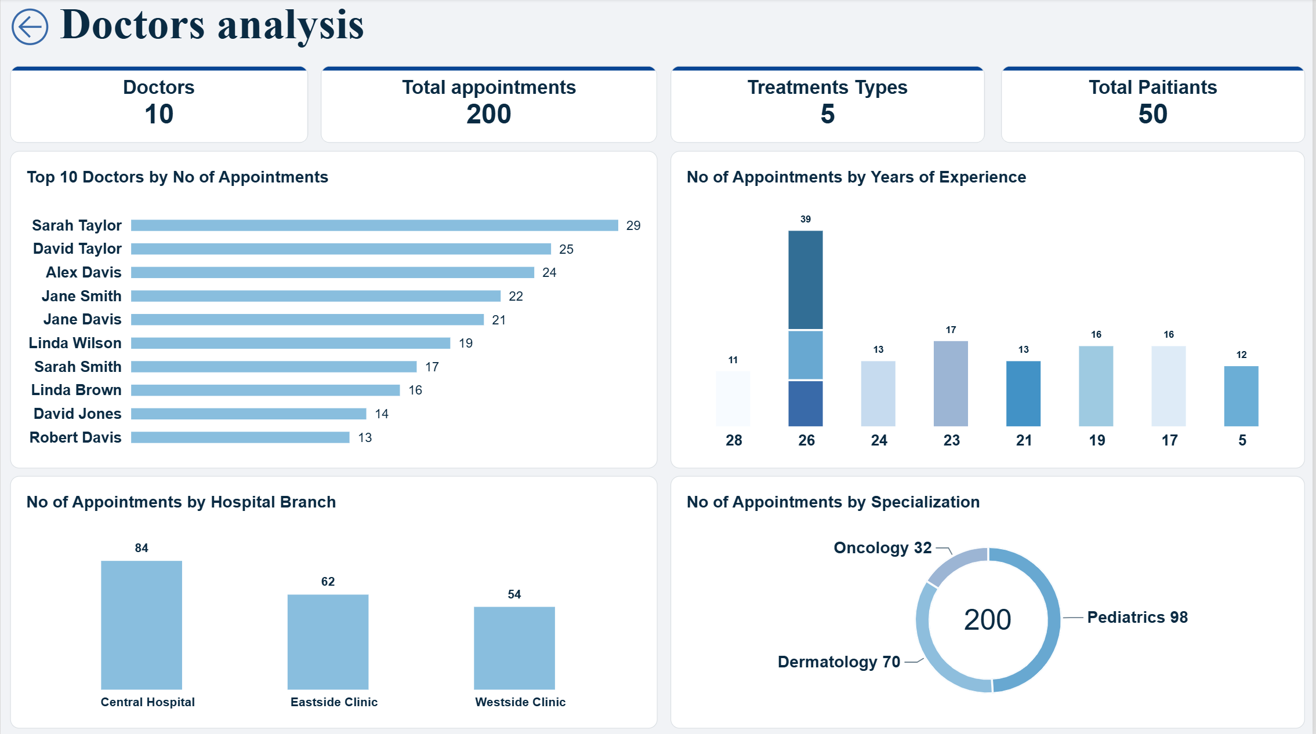
Doctors

Slide 23
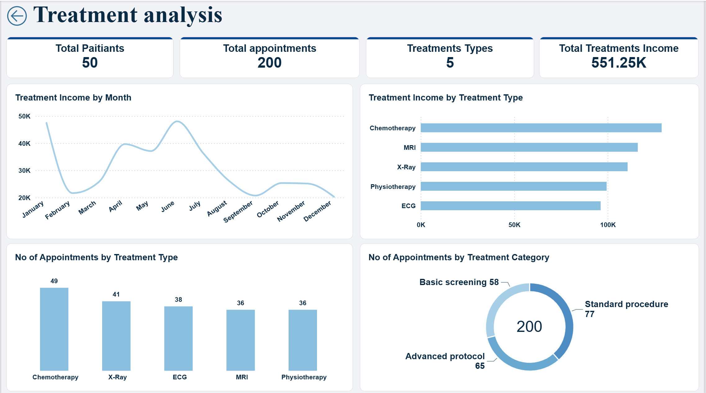
Treatments

Slide 24
Summary
This project involved a complete data analysis workflow using Python, SQL Server, and Power BI. I started by cleaning, transforming, and exploring five hospital datasets using Python. Then, I imported the data into SQL Server, established relationships between tables, and developed 19 SQL queries to answer key business questions. Finally, I used Power BI to transform the analysis into interactive dashboards, providing insights into hospital operations, patient activity, doctor performance, treatment costs, and financial performance.

Slide 25
Thank you

